Slide 1
Utility Computing:
Managing the Challenges
Patrick Lin
VERITAS Software

Slide 2
Agenda
Customer challenges
Utility computing defined
Sample use cases
Lessons learned

Slide 3





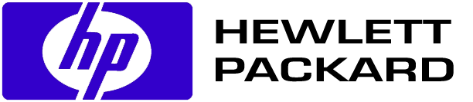
Increasing Complexity and Expectations Heterogeneous, Interdependent, Complex, Always Changing
Client/Server
n-tier, SAN, J2EE, .Net, Web Services
Business Business
Acceleration Differentiation

Slide 4
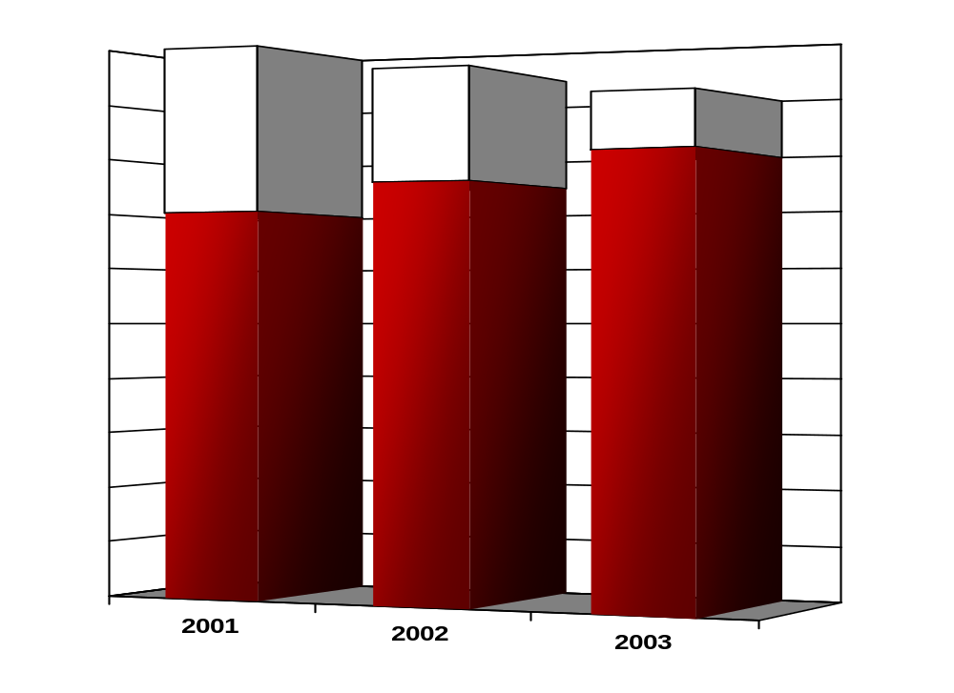
The IT Dilemma
Lower IT Budgets, Increasing Operational Costs
“Differentiation”
Inability For IT To
Create “Differentiation” Due To Lower IT Budgets & Increased Operational Costs
Operational Costs
Notes:
Transition: Now, the challenges described on the previous slide are fundamentally issues for the IT organization. However, there’s also the issue of how those issues affect the business as a whole. IT is strategic for many organizations, in that it enables a level of competitive differentiation.

Slide 5

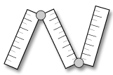
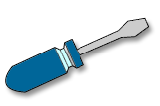
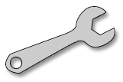
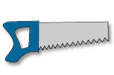
IT Operational Processes
Administrators
Fragmented
Inconsistent
Too many tools
Labor-intensive
Not enough visibility
Component APIs / Element Managers / Administrative Consoles
Applications
Servers
Storage
Notes:
Provisioning resources is a supply chain and change management problem
Practices and policies evolved in the manual world, for the manual supply chain
Resources not shared – organized by silos
Labor-intensive, error-prone, poorly defined and poorly followed management processes
Element managers and scripts
No visibility and no accountability
Lack of trust in automated tools
Self-service implies resource land grab
Multiple participants, poorly coordinated
Operations, development, architecture
Finance, application owners (business units)
Business systems analysts, process owners (rare)
Many tools available
Focused on the same buying centers as the infrastructure that they manage

Slide 6
What is Utility Computing?

Slide 7
What Defines a Utility?
Delivers services over a network
Available to anyone in the service area
Services are standardized
Consumption is measured
Consumers are billed for usage and availability
Taken for granted by its consumers
An approach to running a business that maximizes adaptability to change, cost control, quality of service

Slide 8
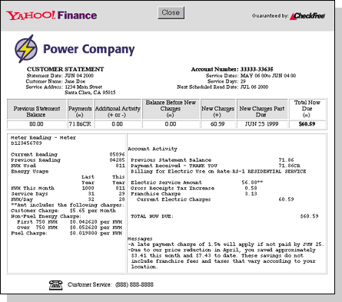

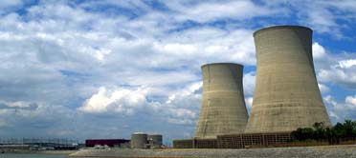
Utility Computing
A Major Shift In The Way IT Delivers Apps/Infrastructure
Accountable and chargeable
  Alignment with business needs
  Detailed usage
  Detailed cost reporting and chargeback
Managed service levels
  Reliable, just-in-time provisioning
  Adapts to business needs
  Automated (not automatic!)
Shared resources
  Optimized utilization
  Reduced operational costs
  Pooling, virtualization and provisioning

Slide 9
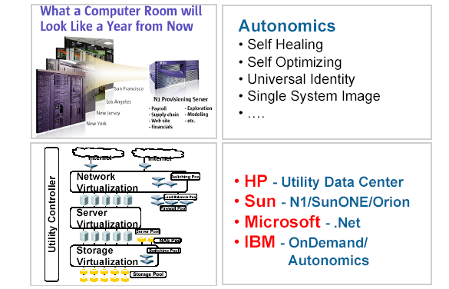
Which Utility Computing?
Hype
Future

Slide 10
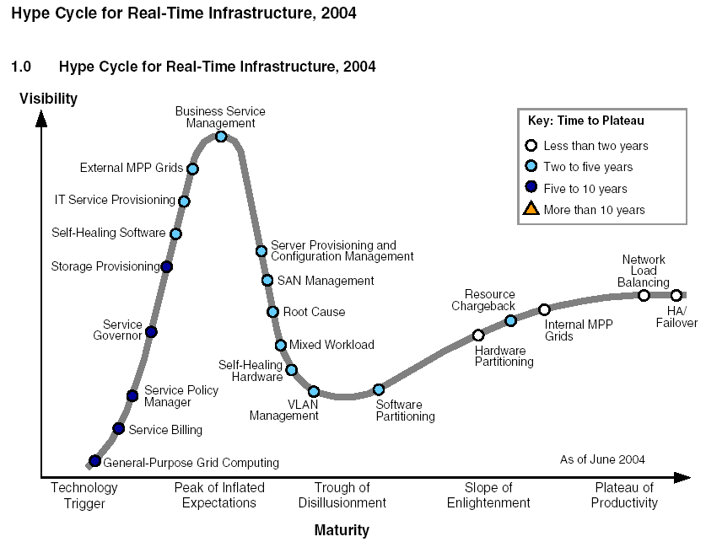
What the Analysts Say…
Gartner Group, 2004

Slide 11


Utility Computing: Evolution of IT
Distributed
Proprietary
Infrastructure
Virtual
Commodity
Infrastructure
Arbitrary
Service Levels
Predictable
Service Levels
Labor Intensive
Management
Automated
Management
Cost Center
Value Center
Notes:
Transition: What’s the way to get out of this dilemma? To fundamentally alter how IT is managed, from a cost center with distributed proprietary infrastructure, arbitrary (and usually unknown) service levels, and labor intensive management; to a value center, with …
Note: When we say “value center” we are not implying that there needs to be chargeback or that IT is a profit center. What you do with the information you have about how the infrastructure is being used is up to you, and we’ve seen everything from information-only uses to a straight-up chargeback scenario.

Slide 12
How Do I Get There?

Slide 13
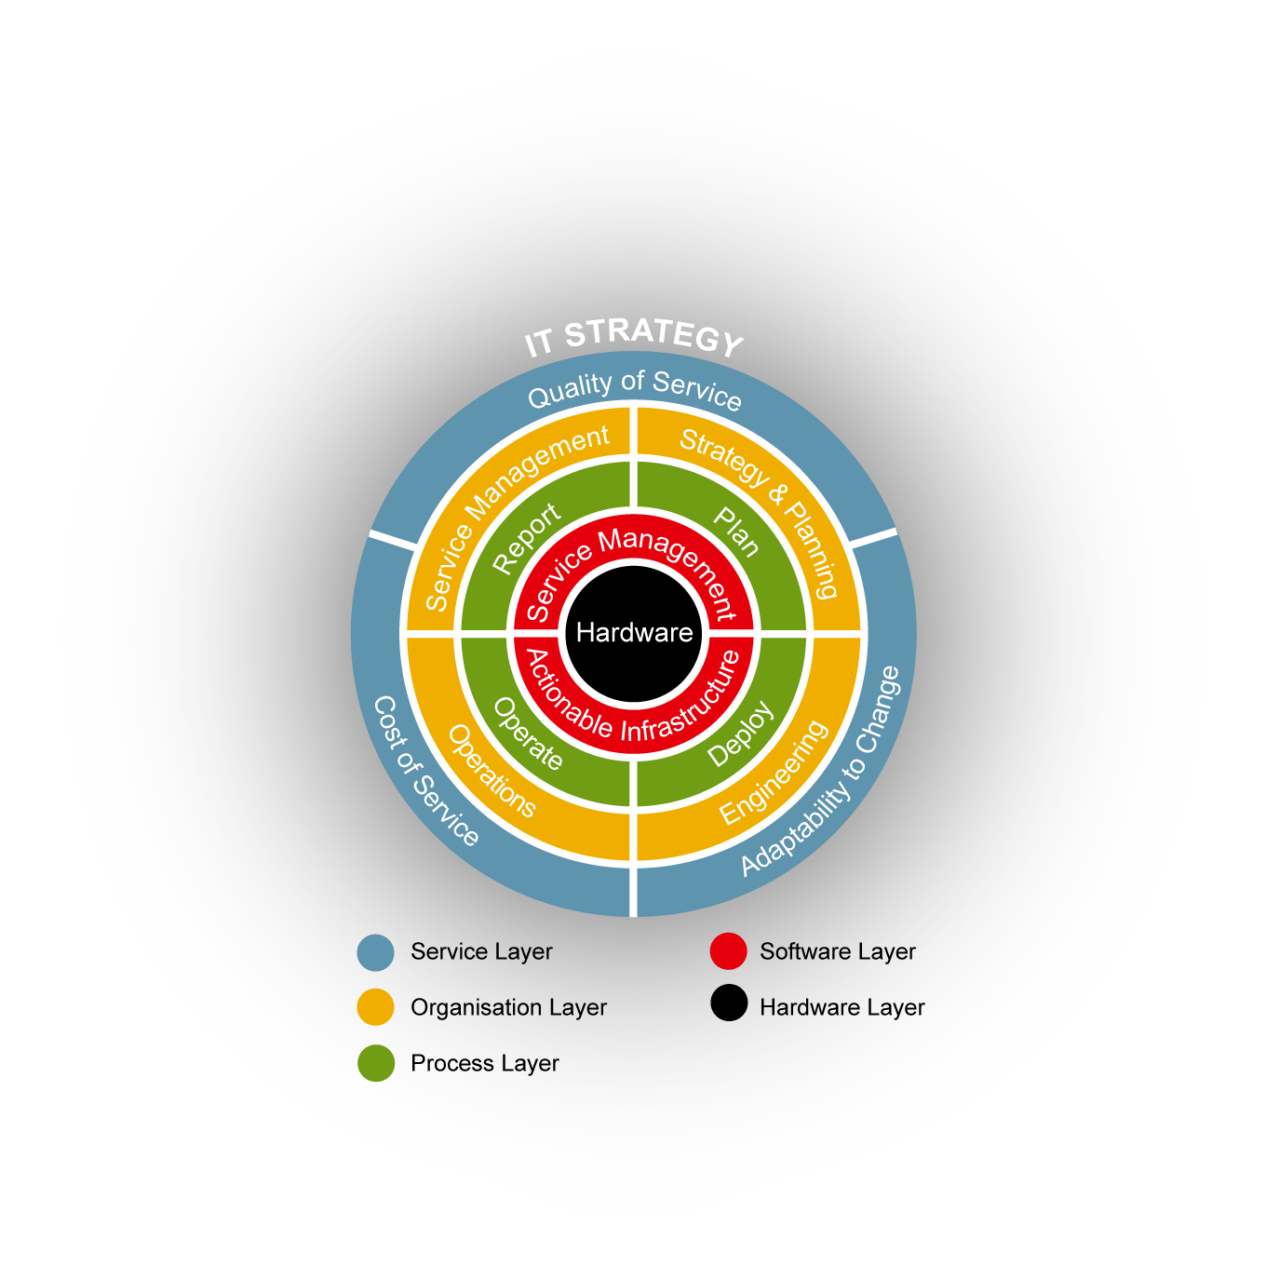
Utility Computing
More Than Technology - Reference Model
Service Layer
  Well defined classes of service
  Charge based on usage
Organization Layer
  Centralized centers of excellence
  Service management disciplines
Process Layer
  Support for service lifecycle
  Automation where possible
  Standardized workflow
Software Layer
  Full abstraction of hardware
  Centralized I.T. management
  I.T. process automation
Hardware Layer
  Commoditized, modular design
  Hierarchical infrastructures
Notes:
Add time metric to service delivery layer (TTM etc.). Adaptability to change..
Actionable infras/service management
Outer layer for I.T. strategies..
Descriptions of layers..
Change s/w layer to reflect Mark B’s slide..

Slide 14
Utility Computing Maturity Model
Major Milestones
Dedicated
Systems
Shared
Infrastructure
Assisted
Management
Service
Management
Utility
Computing

Slide 15
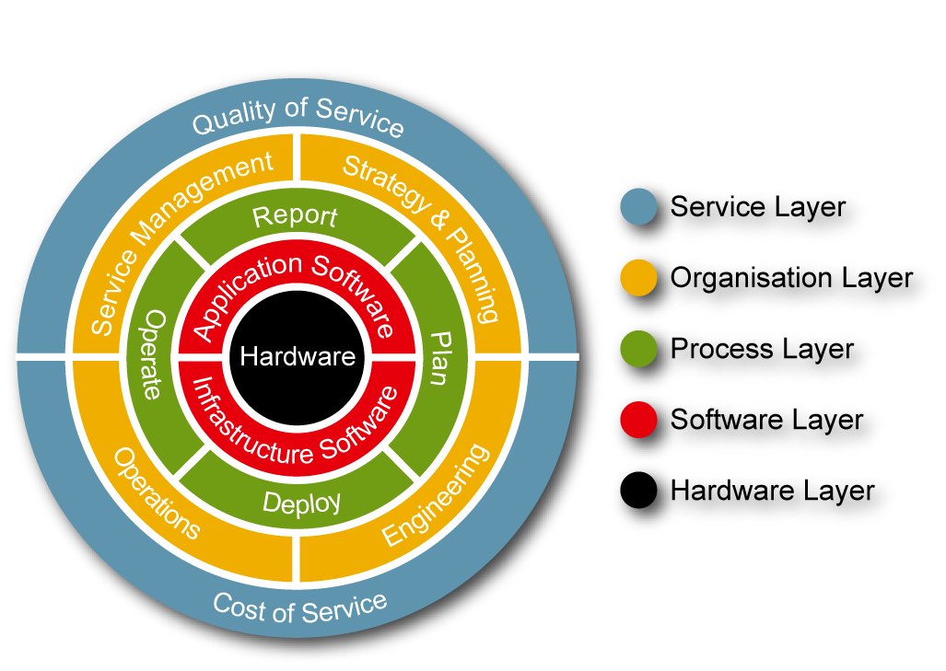
Utility Computing Maturity Model
Major Milestones
Dedicated
Systems
Shared
Infrastructure
Assisted
Management
Service
Management
Utility
Computing
Cost Control
Centralized mgmt
Basic cost awareness
Real-time mgmt views
Standardized technology
Rigorous service. mgmt
Resource optimization
Fully optimized I.T.
Automated chargeback
Low asset utilization
High TCO
Adaptability To Change
Dynamic IT
resources
I.T. dedicated to
function
Dynamic provisioning
Reusable workflows
Actionable infrastructures
JIT provisioning
Virtualized I.T.
Quality Of Service
“Silo Control”
Basic accountability
Basic Class of Service
End to end QOS
Improved data sharing
Self-service portals

Slide 16

Utility Use Case:
Dartmouth College

Slide 17
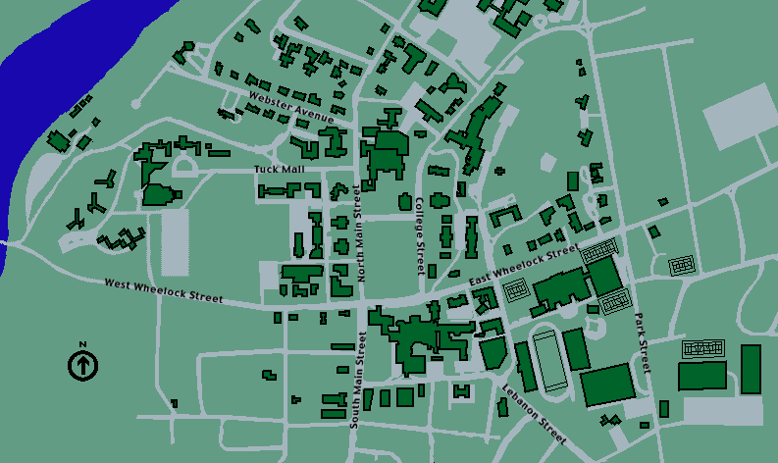
Dartmouth IT Environment
Decentralized, Heterogeneous Infrastructure
Dartmouth Machine Room
Heterogeneous IT environment – Windows, Solaris, AIX, HP-UX, Mac OS, etc.
Storage & Server Growth > 40% annually

Slide 18
Dartmouth Data Protection Utility
Approach: IT Service Lifecycle
Service
Planning
Service
Definition
Service
Cost
Allocation
Service
Request
Service
Level
Reporting
Service Delivery Management
Service Level Management
Service
Approvals
Service
Level
Monitoring
Service
Provisioning

Slide 19
Utility Model Rationale
Improved Records Management & Processes
Centralize IT
  Standardize on backup policies and data recovery procedures (data protection service)
  Provide expert assistance to departments
Improve efficiency
  Enable process efficiencies for service requests
  Improve data management, availability and performance
Transform IT from a cost center to a value center
  Align IT with college needs and demonstrate value
  Charge departments based on usage

Slide 20
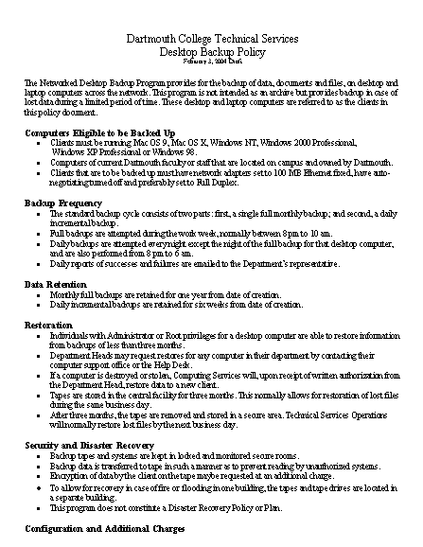
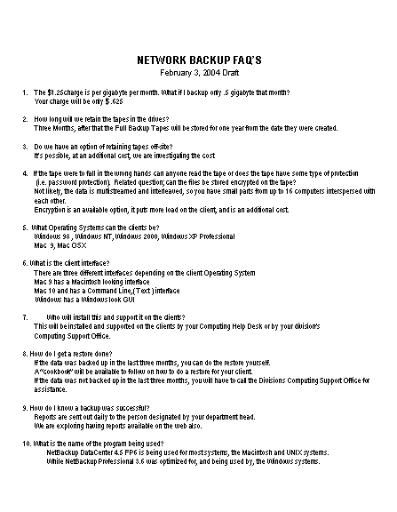
Service Definition
Creating the initial offering
How defined?
How to obtain buy-in?
How supported?

Slide 21
Utility Model Implementation
Reporting & Cost Recuperation Model
Short-term: Offer service as a pilot & learn…
  500 users in select departments
  Creative financing strategy to minimize CapEx
  Usage-based cost allocation with monthly billing cycle automatically deducted
  Accurate & timely usage reporting by department
  Feedback drives increased deployment
Long-term: Create campus-wide offerings
  All faculty, staff, students
  Specific service levels / offerings
  Flat-rate pricing tiers
  Monthly billing automatic
  Accurate & timely reporting
  Expansion beyond data protection (storage, servers, etc.)

Slide 22
Utility Model Benefits
Cost Reduction, Service Improvement
Headcount savings & focus on core competencies
Physical resource savings
(Showcase) IT aligned with college goals/objectives
Service improvement for data recovery
Detailed ROI is underway

Slide 23
Utility Use Case:
Global Financial Services Firm

Slide 24
Background
Consolidation project
Staged deployment over 12 month period
Blueprint for all other global storage utilities
Business case built over 2 years
  Emphasis on utilization
  Waited for stabilization in SAN marketplace:
    Carrier-class switches
    Modular arrays with high-end functionality at right price/performance
Differentiated storage services offered to internal customers

Slide 25
Technical Details
2 Petabyte platform
Approximately 2500 servers attached by end of 2005
Core-edge topology using Cisco MDS
Dual path fabrics
Solaris8 with Emulex HBAs (migration to Solaris10 in 2005)
VxVM 4.0 on every host
EMC Clariion CX700, configured with regular and metaLUNs
Remote replication using Mirrorview or VVR, depending on class of service
Netbackup 5.0
Notes:
The 2PB ceiling is the estimate of data generated by the applications being hosted by the 2500 attached servers over 5 years. Not certain whether accounting strategies were used to determine this limit (depreciation advantages). Most of the applications are non-mission critical data warehousing apps – example is a suite of fraud detection applications. Most applications are Websphere based with Oracle as back-end database. A few mission-critical applications (OLTP) are hosted on the SINUS platform.
The architecture is intended to be replicated to the other current UBS storage projects, with the intention of rolling up statistics and other data to a central CommandCentral repository.

Slide 26
Provisioning Requirements
Integration with existing trouble-ticketing system
Service definitions
  Premium
  Standard
  Economy
Additional service definitions for next version
  Premium+, Standard+, Economy+, Archive
Both automation and manual operation
  Delivers LUNs and/or mount points (volumes) to customers
  Rules-based
Notes:
Service Definitions can be found in the SINUS1 UBS document (internal) only – 70 pages define these services and alignment with applications and business units. Contact john.blumenthal@vertias.com for details.

Slide 27
Provisioning Requirements
Three primary use cases
  Create storage for new or existing host
  Grow storage (volumes and/or LUNs) for existing host
  Free (remove) storage
Rollback to assure SAN integrity
Approval routing and escalation
Scheduling
Create custom charge-back XML to submit to accounting system
Scale to 100 concurrent requests

Slide 28
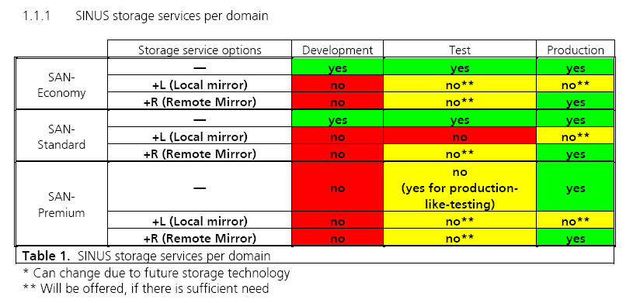
Storage Services Offered

Slide 29
Rationale for Approach
Leverage solution and tight integration across operations (storage and backup)
Accurate information for the business: Reporting and mapping of resources by Project / Owner
Forward step to delivering true charge-back model to customers: bill-back & tiered price offerings
Improved quality and consistency of service levels (delivery time, accuracy, information)
Controlled acquisition & deployment model: Bite-size vs all-or-nothing

Slide 30

How You Get There…
Five Steps To Utility Computing
Utility Computing
Automated
Management
Service
Predictable Service Levels
Automate
Virtual Commodity
Infrastructure
Standardize
Consolidate
Discover
Notes:
We’ve stated the transformations that IT departments have to go through but we’ve not explained how to get there. There are a number of logical steps which you need to follow to move to a Utility Computing model
- First and foremost you need to discover assets you have in your IT department. Sounds crazy I know but its staggering how many people keep this in Excel or in notebooks.
- Second, once you understand what you’ve got you can start to re-architect and consolidate your environment to gain efficiencies in administrator productivity and resource utilization.
Third, start to standardize – classify your applications and agree upon specific vendors for necessary level of storage and server hardware that will run them. Manage the entire environment using a standard set of software tools so application service levels become measured and predictable.
Fourth, automate. Start to drive down the time and labor that is required to request, provision and manage the environment. Good automation drives down cost, improves application service levels (less human intervention) and makes IT a more predictable organization to interact with (interact with a computer, not a person).
Finally, move to a true service provider model by equating service level delivery with cost. Costs maybe allocated or charged back to business units on a usage basis.

Slide 31
Utility Computing
Transformation Methodology
Dedicated
Systems
Shared
Infrastructure
Assisted
Management
Service
Management
Utility
Computing
Business Interface
No SLA’s
Arbitrary SLA’s
Basic Class Of Service
Business Level Reporting
End-End Service Mgmt
Utility Services
I.T. Organization
Distributed Functions
Distributed Competence
Centers Of Excellence
Simple Service Mgmt
Discipline
Comprehensive Svc Mgmt
Discipline
IT Value Center
I.T. Processes
Bespoke processes
Basic Mgmt Workflows
Routine Task Automation
Comprehensive Automation
Fully Automated IT
Software Capability
Non-Standardized
No Hardware Abstraction
Basic Storage Abstraction
Centralized Mgmt Tools
Std Software Tools
Basic Auto Provisioning
Service Lifecycle Mgmt
Actionable Infrastructure
End-End Utility Mgmt
Hardware Capability
Distributed, Proprietary
Hierarchical Modular
Architecture
Shared Storage
Shared Server Pools
Commodity Hardware
Notes:
Describe each of the maturity stages..Use previous slide
Use build to describe dedicated sys. -> shared infrastructure -: assist. Mgmt. -> full build

Slide 32
Takeaways (What Customers Say)
Integration, centralization, virtualization
  Deal with the heterogeneity and complexity
Visibility into utilization and cost is key
  Show me what I have, who’s using what
Standardized templates, rules, catalogs
  Help me develop best practices
Configuration / lifecycle of assets is key
  It’s not just about provisioning
Starting at just one layer of infrastructure
  All apps and infrastructure…over time

Slide 33
